Slide 1
By J. Wilson
L.O. To understand the concept of similarity, calculate scale factors and use scale factors to calculate missing sides.

Slide 2
Similar Shapes
Two shapes are said to be similar to each other if one is an enlargement of the other.
Angles stay the same, side lengths change
What do you notice about the length of the sides?
What do you notice about the size of the angles?

Slide 3
Congruence
Two shapes are said to be congruent if they stay the same shape and size
The shapes may be a reflection of each other, or be rotated or translated
Angles and side lengths are the same

Slide 4
24
7
30
Similar Triangles
Date
EQ – How do I calculate the scale factor?
Similar triangles are triangles having the same shape but different size.
Similar objects can be enlargements or dilations.
The side lengths change but the angle sizes stay the same
Enlargements have all sides made larger by the same factor.
Dilations have all sides made smaller by the same factor.

Slide 5
Lets try together - Which are congruent and which are similar?
Notes:
Clicking a correct shape will remove it from the screen. Clicking an incorrect one will bring up the red circle.

Slide 6
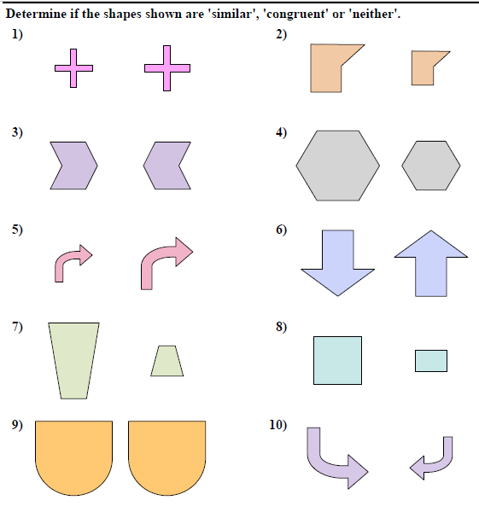
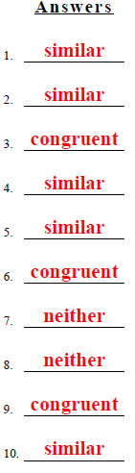
Your turn – Write down if these are congruent, similar or neither?

Slide 7
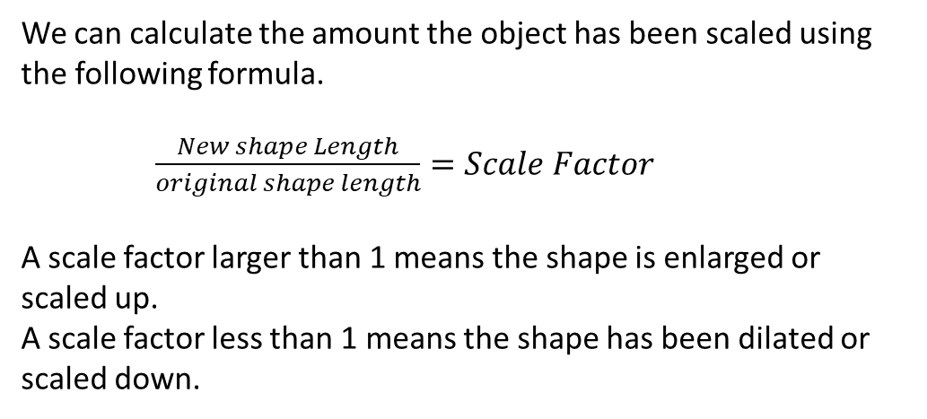
24
7
30
Similar Triangles
Date
EQ – How do I calculate the scale factor?
Similar triangles are triangles having the same shape but different size.
The side lengths change but the angle sizes stay the same
Similar objects can be enlargements or dilations.
Enlargements have all sides made larger by the same factor.
Dilations have all sides made smaller by the same factor.
We can calculate the amount the object has been scaled using the following formula.
$\frac{New shape Length}{original shape length}=Scale Factor$
A scale factor larger than 1 means the shape is enlarged or scaled up.
A scale factor less than 1 means the shape has been dilated or scaled down.

Slide 8
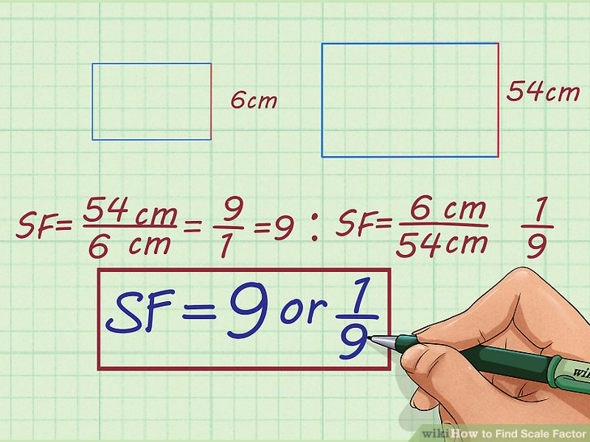
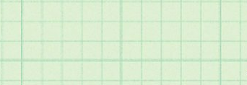
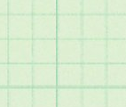
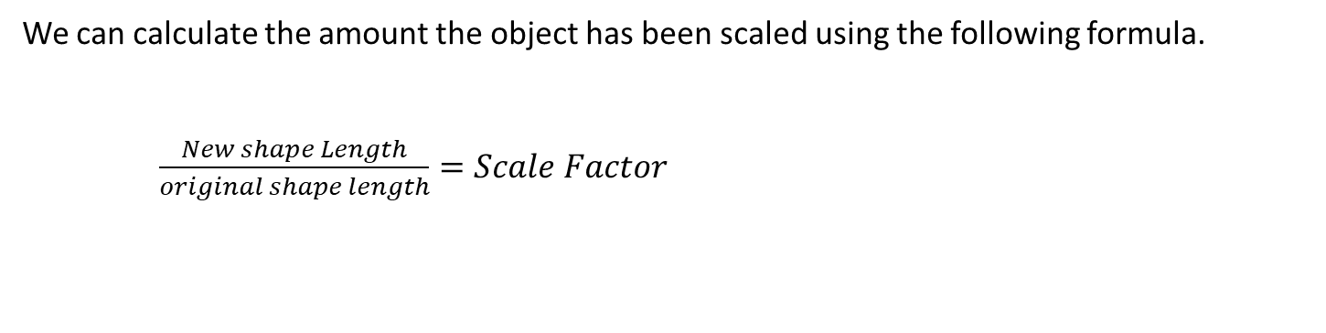
Example1. The original shape is on the left
We can calculate the amount the object has been scaled using the following formula.
$\frac{New shape Length}{original shape length}=Scale Factor$
In this case, the scale factor is greater than 1 so the shape has been enlarged.
If the shape is similar than all corresponding sides will give the same scale factor (more on this rule tomorrow).

Slide 9
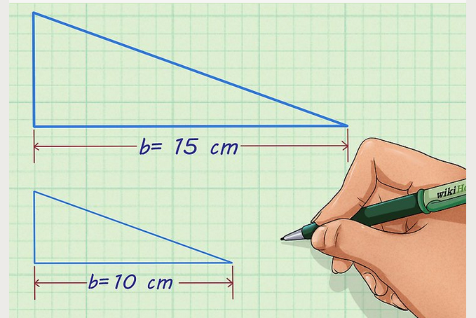
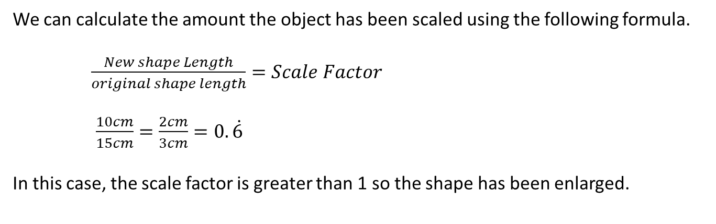
Example 2. The original shape is on top
We can calculate the amount the object has been scaled using the following formula.
$\frac{New shape Length}{original shape length}=Scale Factor$
$\frac{10cm}{15cm}=\frac{2cm}{3cm}=0.\dot{6 }$
In this case, the scale factor is greater than 1 so the shape has been enlarged.

Slide 10
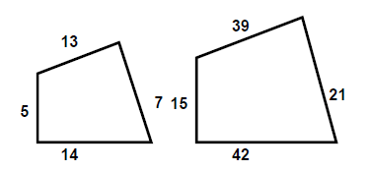
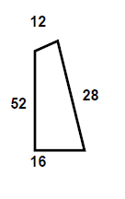
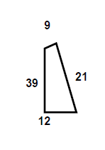
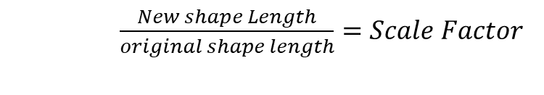

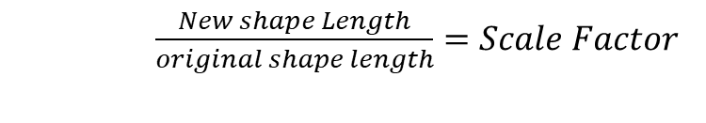
Your turn. Find the Scale factor for these 2 sets of shapes.
$\frac{New shape Length}{original shape length}=Scale Factor$
Original
$\frac{21cm}{7cm} or$ $\frac{15cm}{5cm}or\frac{39cm}{13cm}or$ $\frac{42cm}{14cm}=\frac{3}{1}=3$
$\frac{New shape Length}{original shape length}=Scale Factor$
$\frac{21cm}{28cm} or$ $\frac{9cm}{12cm}or\frac{39cm}{52cm}or$ $\frac{12cm}{16cm}=\frac{3}{4}=0.75$
Original

Slide 11
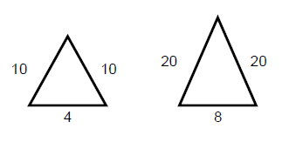
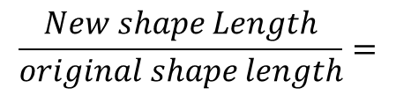
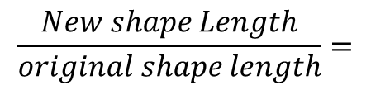

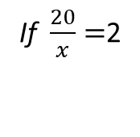
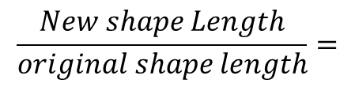


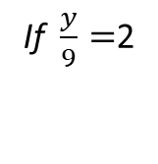
Finally, if we know the scale factor, and we know the shapes are similar, we use that to find the lengths of unknown sides.
Find the scale factor
$$\frac{New shape Length}{original shape length}=$$
$\frac{8}{4}=\frac{2}{1}=$2
9
x
y
original
Use the scale factor to find the missing sides
$$\frac{New shape Length}{original shape length}=$$
If $\frac{20}{x}=$2
$$then x must=10$$
$$\frac{New shape Length}{original shape length}=$$
If $\frac{y}{9}=$2
$$then y must=18$$

Slide 12
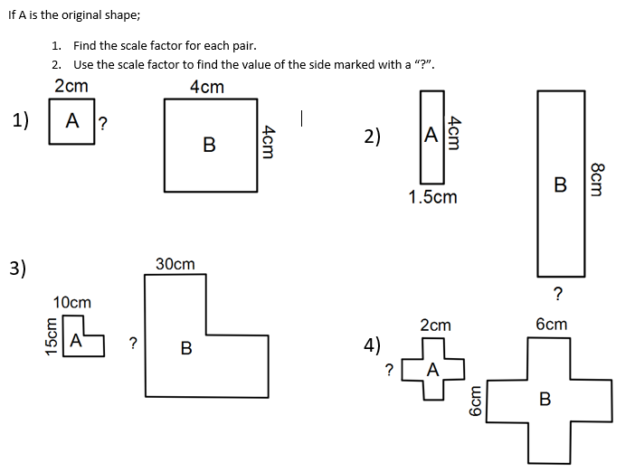
Your Turn

Slide 13
